Slide 1
Overview of Acts
CG Leader Training
9/17/17

Slide 2
Introduction to Acts
Who wrote Acts?
  Luke (Same Luke who wrote the Gospel of Luke)
    Not one of the 12 Disciples of Jesus!
    Faithful companion of Paul
      Col. 4:14, 2 Tim 4:11, Phil. 1:24, and evidenced by “we” references in Acts
    Most likely a Gentile by birth
    Physician by Profession - Col. 4:14
When was the book written?
  Likely ~AD 63 (Roughly 30 years after Jesus’ ascension into Heaven)
    The last events recorded in Acts occurred in ~ AD 62
    Prior to the burning of Rome and persecution of Christians which began in AD 64. (Luke likely would have recorded these in Acts if they had happened…)
    Prior to Paul & Peter’s martyrdom in ~AD 67
Where was the book written?
  Likely from Rome where Luke was staying with Paul during Paul’s imprisonment there.

Slide 3
Introduction to Acts cont.
Why did Luke write the book of Acts?
  Luke 1:1-4 Inasmuch as many have undertaken to compile a narrative of the things that have been accomplished among us, ² just as those who from the beginning were eyewitnesses and ministers of the word have delivered them to us, ³ it seemed good to me also, having followed all things closely for some time past, to write an orderly account for you, most excellent Theophilus, ⁴ that you may have certainty concerning the things you have been taught.
  Acts 1:1-3 In the first book, O Theophilus, I have dealt with all that Jesus began to do and teach, ² until the day when he was taken up, after he had given commands through the Holy Spirit to the apostles whom he had chosen. ³ He presented himself alive to them after his suffering by many proofs, appearing to them during forty days and speaking about the kingdom of God.
    The Gospel of Luke tells the story of Jesus and His ministry.
    Acts picks up where The Gospel of Luke leaves off and records the events of the next ~30 years after Jesus ascends into Heaven.
Luke wrote the Gospel of Luke and the book of Acts to give an accurate and orderly account of the origins of Christianity.
Notes:
Luke was not an eyewitness to the events in The Gospel of Luke, but he interviewed those who were
In Luke’s time there was no Bible as we know it, and while the pieces of the OT existed there was no NT. False prophets and teachers abounded as evidenced by Paul and Peter’s letters. Luke wanted to set the record straight!

Slide 4
Major Themes in Acts
Conveyance of the promised Holy Spirit
Formation & spread of the Church
Launch of the Great Commission
Note: The conveyance of the Holy Spirit is the engine that drives the other two themes!
Notes:
The Conveyance of the promised Holy Spirit is the cornerstone upon which the other two themes are built

Slide 5
Conveyance of the Promised Holy Spirit
Who is the Holy Spirit and what is the Holy Spirit’s role in the world?
The Holy Spirit is the member of the Trinity whom the Scripture most often represents as being present to do God’s work in the world. (This is especially true after Jesus’ ascension into Heaven.)
The work of the Holy Spirit is to manifest the active presence of God in the world, to give indications that make the presence of God known.
4 General Aspects of the Holy Spirit’s work to bring evidence of God’s presence
The Holy Spirit Empowers
The Holy Spirit Purifies
The Holy Spirit Reveals
The Holy Spirit Unifies
Notes:
The Holy Spirit works to complete and sustain what God the Father has planned and what God the Son has begun.
When the Holy Spirit works in perceivable ways it encourages people’s faith through knowing God is near and is working to fulfill his purposes in the church and to bring blessing to his people.

Slide 6
Conveyance of the Promised Holy Spirit
The Holy Spirit before Acts
  The Holy Spirit was active in the world as recorded in Scripture prior to Acts 2, but rarely indwelt individuals and generally not for more than short periods of time. One notable exception was Jesus. (John 1:32, Luke 3:22) Jesus was without sin, so the Holy Spirt was delighted to indwell Him permanently. The Holy Spirit did not indwell individuals prior to Jesus death & resurrection because the penalty for sin had not yet been paid. (i.e. House cleaning was needed before the Holy Spirit could move in!)
Examples of the Holy Spirit in the OT (Not a comprehensive list…)
- Genesis 1:2 - …The Spirit of God was hovering over the face of the waters.
  - Exodus 31:3, 35:31, 35:34 - Bazalel, God’s chosen artist to construct His tabernacle
  - Numbers 11:25 – 26 - The elders of the Isrealites are caused to prophesy
  - Numbers 27:18 & Deut. 34:9 - Joshua, God’s chosen leader of His people
  - Judges 3:10, 6:34, 11:29, 13:25, 14:6, 14:19, 15:14 - Judges of Israel
  - 1 Samuel 19:20-24 - King Saul & his messengers
  - 1 Samuel 16:13 & Psalm 51 - King David
  - Daniel 4:8-9, 18 & 5:11 - Daniel as he serves in Babylon
Notes:
Mentions of the Holy Spirit working within someone in the OT: Joshua (Num 27:18, Deut. 34:9); Ezekiel (Ezek. 2:2, 3:24); Daniel (Dan 4:8-9, 18, 5:11); Micah (Mic. 3:8)
Listen to West’s sermon “The Spirit According to John” 10/9/16

Slide 7
Conveyance of the Promised Holy Spirit
When was the Holy Spirit Promised? (Not a comprehensive list…)
  Ezekiel 36:26-27; 37:14
    Ezekiel prophesied God would place his Spirit within and change people as a result
  Joel 2:28-29 (Quoted by Peter in his 1st sermon on Pentacost)
    Joel prophesied God would pour out his Spirit upon all types of people, not just rulers, prophets, etc.
  John 16:5-15
    Jesus promises the Holy Spirit would come after He had left them
    West’s sermons “The Spirit According to John” 10/9/16 & “How the Helper Helps” 10/16/16 Listen to these sermons again, and have your group do it too!!
  Luke 24:44-49
    Jesus reiterates the promise of the Holy Spirit in His last words to His disciples and instructs them to wait in Jerusalem until they “are clothed with power from on high.”
  Acts 1:1-14
    Luke restates and expands upon the promise and Jesus’ instruction to the disciples
Notes:
Mentions of the Holy Spirit working within someone in the OT: Joshua (Num 27:18, Deut. 34:9); Ezekiel (Ezek. 2:2, 3:24); Daniel (Dan 4:8-9, 18, 5:11); Micah (Mic. 3:8)
Listen to West’s sermon “The Spirit According to John” 10/9/16

Slide 8
Conveyance of the Promised Holy Spirit
The Promise of the Holy Spirit
  John 16:5-15 ⁵ But now I am going to him who sent me, and none of you asks me, ‘Where are you going?’ ⁶ But because I have said these things to you, sorrow has filled your heart. ⁷ Nevertheless, I tell you the truth: it is to your advantage that I go away, for if I do not go away, the Helper will not come to you. But if I go, I will send him to you. ⁸ And when he comes, he will convict the world concerning sin and righteousness and judgment: ⁹ concerning sin, because they do not believe in me; ¹⁰ concerning righteousness, because I go to the Father, and you will see me no longer; ¹¹ concerning judgment, because the ruler of this world is judged. ¹² “I still have many things to say to you, but you cannot bear them now. ¹³ When the Spirit of truth comes, he will guide you into all the truth, for he will not speak on his own authority, but whatever he hears he will speak, and he will declare to you the things that are to come.¹⁴ He will glorify me, for he will take what is mine and declare it to you.¹⁵ All that the Father has is mine; therefore I said that he will take what is mine and declare it to you.
  Luke 24:44-49 ⁴⁴ Then he said to them, “These are my words that I spoke to you while I was still with you, that everything written about me in the Law of Moses and the Prophets and the Psalms must be fulfilled.” ⁴⁵ Then he opened their minds to understand the Scriptures, ⁴⁶ and said to them, “Thus it is written, that the Christ should suffer and on the third day rise from the dead, ⁴⁷ and that repentance for^{[c]} the forgiveness of sins should be proclaimed in his name to all nations, beginning from Jerusalem. ⁴⁸ You are witnesses of these things. ⁴⁹ And behold, I am sending the promise of my Father upon you. But stay in the city until you are clothed with power from on high.”
Notes:
Mentions of the Holy Spirit in the OT: Genesis 1:1, Psalm 51:11, Isaiah 63:10-11, etc.
Listen to West’s sermons “The Spirit According to John” 10/9/16 and “How the Helper Helps” 10/16/16

Slide 9
Conveyance of the Promised Holy Spirit
Setting the Stage:
  Acts 1:4 & 12-15 - ⁴ And while staying[a] with them he ordered them not to depart from Jerusalem, but to wait for the promise of the Father, which, he said, “you heard from me; ⁵ for John baptized with water, but you will be baptized with[b] the Holy Spirit not many days from now.” ….. ¹² Then they returned to Jerusalem from the mount called Olivet, which is near Jerusalem, a Sabbath day's journey away. ¹³ And when they had entered, they went up to the upper room, where they were staying, Peter and John and James and Andrew, Philip and Thomas, Bartholomew and Matthew, James the son of Alphaeus and Simon the Zealot and Judas the son of James. ¹⁴ All these with one accord were devoting themselves to prayer, together with the women and Mary the mother of Jesus, and his brothers.^{[c]} ¹⁵ In those days Peter stood up among the brothers (the company of persons was in all about 120)…
  Jesus was gone, the only leader this group of 120 followers had ever known
  Now what??? They found themselves huddled together waiting for the promised Holy Spirit assuredly filled with questions and all kinds of emotions.
    Their fellow Jews had just brutally killed their leader
    They didn’t have the indwelling Holy Spirit, the New Testament, Christian podcasts, Google, etc. to try and figure out what to do next! They knew only to wait for the promised Helper, and I’m sure they were all hoping He would help!

Slide 10
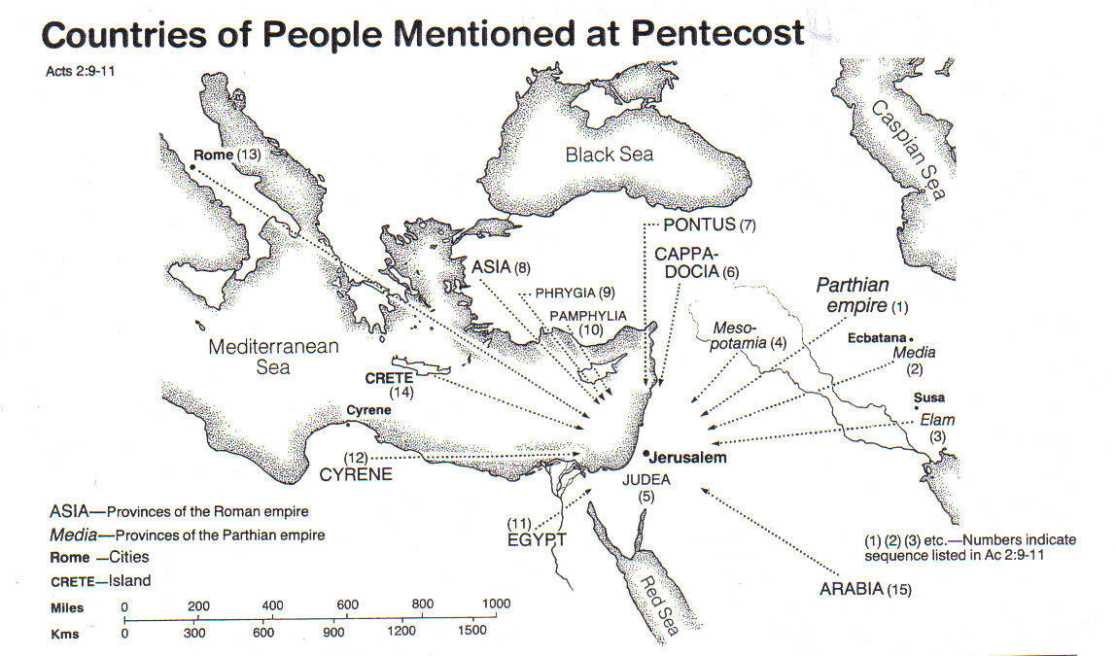
Conveyance of the Promised Holy Spirit
Setting the Stage Cont.:
  The Holy Spirit comes upon followers of Christ on the Day of Pentacost
    Day of Pentacost: Annual Jewish celebratory feast held 50 days after the Passover week
      ~ 3 days after Jesus ascended into Heaven??? (John 20:1-10, Acts 1:3)
      Jews from around the world would be in Jerusalem to celebrate the feast
Notes:
Peter quotes Joel 2:28-32, Psalm 16:8-11, 2 Samual 7:12, Psalm 110
The fisherman who a few weeks ago denied Jesus 3 times to a young girl!
Acts 4:13 – Uneducated & Untrained

Slide 11
Conveyance of the Promised Holy Spirit
Acts 2:1-12 When the day of Pentecost arrived, they were all together in one place. ² And suddenly there came from heaven a sound like a mighty rushing wind, and it filled the entire house where they were sitting. ³ And divided tongues as of fire appeared to them and rested^{[a]} on each one of them. ⁴ And they were all filled with the Holy Spirit and began to speak in other tongues as the Spirit gave them utterance.⁵ Now there were dwelling in Jerusalem Jews, devout men from every nation under heaven. ⁶ And at this sound the multitude came together, and they were bewildered, because each one was hearing them speak in his own language. ⁷ And they were amazed and astonished, saying, “Are not all these who are speaking Galileans? ⁸ And how is it that we hear, each of us in his own native language? ⁹ Parthians and Medes and Elamites and residents of Mesopotamia, Judea and Cappadocia, Pontus and Asia, ¹⁰ Phrygia and Pamphylia, Egypt and the parts of Libya belonging to Cyrene, and visitors from Rome, ¹¹ both Jews and proselytes, Cretans and Arabians—we hear them telling in our own tongues the mighty works of God.” ¹² And all were amazed and perplexed, saying to one another, “What does this mean?”
Notes:
Tongues of fire portrayed the presence of God. (Burning Bush, Pillar of Fire by Night, The Lord on Mt. Sinai, Pillar of Fire on the Tabernacle)
Proselytes – convert (convert to Judaism in this instance.)
Galileans had a very distinct accent

Slide 12
Conveyance of the Promised Holy Spirit
What Does this Mean!? (vs 12) Why was this such a big deal?
Remember our discussion about the work of the Holy Spirit in the World…
The work of the Holy Spirit is to manifest the active presence of God in the world, to give indications that make the presence of God known.
4 General Aspects: Empowers, Purifies, Reveals, Unifies
What indications do we see that make the presence of God known in Acts 2:1-12?
A sound like a mighty rushing wind that filled the house (vs 2) - Reveals
“Tongues of fire” that rested on each of them (vs 3) - Reveals
  Fire often used in the OT to portray the presence of God
    Moses & the Burning Bush, Pillar of fire by night to lead the Israelites in the wilderness, The Lord on Mt. Sinai, The pillar of fire resting on the tabernacle, etc.
Galileans speaking in foreign tongues from around the know world (vs 4) - Reveals
This was a big event and God wanted to make sure people didn’t miss it. He wanted people to be aware he was doing something remarkable! This theme continues throughout the book of Acts.
Notes:
Tongues of fire portrayed the presence of God. (Burning Bush, Pillar of Fire by Night, The Lord on Mt. Sinai, Pillar of Fire on the Tabernacle)
Proselytes – convert (convert to Judaism in this instance.)
Galileans had a very distinct accent

Slide 13
Conveyance of the Promised Holy Spirit
Gifts of the Holy Spirit Manifested in Acts
  Boldness to Proclaim the Gospel & truth about Jesus - Empowers
  Divine wisdom and understanding of prophecy and Scripture - Reveals
    Peter’s 1st Sermon - Acts 2:14-36
      The uneducated fisherman who denied Jesus 3 times to a young girl weeks before stands before a crowd of Jews and boldly proclaims the man that they killed was the Christ who now sits at the right hand of God and poured out the promised Holy Spirit. And he does so quoting Joel, 2 Samual, and multiple passages from Psalms!
    Peter’s 2nd Sermon - Acts 3:12-26
      ¹³ The God of Abraham, the God of Isaac, and the God of Jacob, the God of our fathers, glorified his servant^{[a]} Jesus, whom you delivered over and denied in the presence of Pilate, when he had decided to release him. ¹⁴ But you denied the Holy and Righteous One, and asked for a murderer to be granted to you, ¹⁵ and you killed the Author of life, whom God raised from the dead. To this we are witnesses.
    Peter Confronts the Sanhedrin - Acts 4:8-13 (I.e. The religious leaders that had Jesus killed!)
      ⁸ Then Peter, filled with the Holy Spirit, said to them, “Rulers of the people and elders, ⁹ if we are being examined today concerning a good deed done to a crippled man, by what means this man has been healed,¹⁰ let it be known to all of you and to all the people of Israel that by the name of Jesus Christ of Nazareth, whom you crucified, whom God raised from the dead—by him this man is standing before you well. ¹¹ This Jesus^{[a]} is the stone that was rejected by you, the builders, which has become the cornerstone.^{[b]} ¹² And there is salvation in no one else, for there is no other name under heaven given among men^{[c]} by which we must be saved.”¹³ Now when they saw the boldness of Peter and John, and perceived that they were uneducated, common men, they were astonished. And they recognized that they had been with Jesus
Notes:
Peter quotes Joel 2:28-32, Psalm 16:8-11, 2 Samual 7:12, Psalm 110
“Holy Spirit” mentioned 42 times in the book of Acts

Slide 14
Conveyance of the Promised Holy Spirit
  Miraculous Healings - Empowers
      Acts 3:1-9 - Peter heals a 40 year old cripple at the temple gate
      Acts 5:15-16 - Peter’s shadow heals the sick he passes by
      Acts 9:32-35 - Peter heals a paralytic
      Acts 9:36-43 - Peter raises Dorcas from the dead
      Acts 13:9-11 - Paul combats Elymas the sorcerer and temporarily blinds him
      Acts 17:18 - Paul casts out a demon from a young girl
  Peace in the Midst of Adversity - Empowers
      Acts 5:40-42 - Apostles rejoice after being beaten in Jesus name
      Acts 7:54-60 - Stephen while being martyred
      Acts 16:23-25 - Paul and Silas praying and praising God from prison after a beating
  Guidance and Direction - Reveals
      Acts 8:29 - Directs Philip to go up to the Ethiopian Eunuch's chariot
      Acts 8:39-40 - the Spirit of the Lord caught Philip away…to Azotus
      Acts 10:15,19-20 - Directs Peter to Cornelius’s house & to not call common what He calls clean
      Acts 15:28 - Directs the Jerusalem Council in their decision towards gentile believers
      Acts 16:6-7 - Prohibited Paul from preaching in Asia & Bithynia
      Acts 13:2-4 - Directed Paul & Barnabas be set apart as missionaries
      Acts 11:28 - Directs Agabus to foresee a great oncoming famine throughout the world
      Acts 20:22-23 - Directs Paul to Jerusalem
      Acts 20:28 - Led Paul to appoint certain elders over the church in Ephesus
  Unity Amongst Believers - Unifies
      Acts 2:44-47 - “All who believed were together and had all things in common…”
      Acts 4:32-37 - “Now the multitude who believed were of one heart and one soul…”
Notes:
Just some examples, not a comprehensive list!!!

Slide 15
Conveyance of the Promised Holy Spirit
Notes & Application:
Christians post-Acts 2 are indwelt with the Holy Spirit at the time of salvation (I Cor. 3:16 & 6:19-20, Romans 8:1-17) except for a few specific examples for specific reasons.
When the book of Acts talks about believers being “filled with the Spirit” post Acts 2 it was not that they weren’t indwelt with the Holy Spirit prior to that, it is that the Holy Spirit was acting within them in extra measure for a specific end or purpose.
Example: Acts 4:8a Then Peter, filled with the Holy Spirit, said to them…
Though we didn’t cite any specific examples of the Holy Spirits work of purification in the book of Acts, the work is actually clear throughout. Without the purifying work of the Holy Spirit in the apostles lives for example there never would have been the unity we see evidenced throughout. These were the guys that were asking to sit at Jesus right hand in Heaven and jockeying for which one of them was the greatest among the group! Sanctification had certainly taken place.
Acts 19:1-6 - It seems these “disciples” were not yet Christians when Paul first met them. They had believed John the Baptist and been convicted of their sin and their need for a Savior, but had not yet put their faith in Jesus as that Savior. After Paul explained that Jesus was the fulfillment of John’s prophesy the “disciples” put their faith in Him and were re-baptized and received the Holy Spirit as evidenced by their speaking in tongues.
Acts 8:14-17 - The Holy Spirit was delayed in coming to the Samaritans to allow Peter & John to personally witness and authenticate the work and welcome the new believers into the church

Slide 16
Major Themes in Acts
Conveyance of the promised Holy Spirit
Formation & spread of the Church
Launch of the Great Commission
Look for how the Holy Spirit acts as the engine that drives the formation and spread of the Church.
Notes:
The Conveyance of the promised Holy Spirit is the cornerstone upon which the other two themes are built

Slide 17
Formation & Spread of the Church
“Church” only mentioned twice in Scripture prior to Acts
  Matthew 18:17 - Jesus is giving instruction for confronting a brother in sin
  Matthew 16:13-20 ¹³ Now when Jesus came into the district of Caesarea Philippi, he asked his disciples, “Who do people say that the Son of Man is?” ¹⁴ And they said, “Some say John the Baptist, others say Elijah, and others Jeremiah or one of the prophets.” ¹⁵ He said to them, “But who do you say that I am?” ¹⁶ Simon Peter replied, “You are the Christ, the Son of the living God.” ¹⁷ And Jesus answered him, “Blessed are you, Simon Bar-Jonah! For flesh and blood has not revealed this to you, but my Father who is in heaven. ¹⁸ And I tell you, you are Peter, and on this rock^{[b]} I will build my church, and the gates of hell^{[c]} shall not prevail against it. ¹⁹ I will give you the keys of the kingdom of heaven, and whatever you bind on earth shall be bound in heaven, and whatever you loose on earth shall be loosed^{[d]} in heaven.” ²⁰ Then he strictly charged the disciples to tell no one that he was the Christ.
“Church” is mentioned 20 times in the book of Acts
  “Church” as the general body of Christians throughout the world
    Acts 5:11, 12:1, 8:3, 9:31
  “Church” as a group of specific believers in a certain geographic location who met together
    Acts 8:1, 11:1, 11:22, 11:26, 12:5, 13:1, 14:23, 14:27, 15:3, 15:4, 15:22, 15:41, 16:5, 18:22, 20:17, 20:28
Notes:
Caesarea Philippi – city on the eastern side of the Sea of Galilee filled with temples to pagan gods

Slide 18
Formation & Spread of the Church
Acts 1 – 12 Peter serves as the foundation upon which Christ’s Church begins to be built (Fulfillment of Jesus’ prophecy in Matthew 16:18)
  Acts 1:15-26 - Peter leads the church of ~120 in selecting a replacement for Judas
  Acts 2:14-40 - Peter preaches at Pentacost & 3,000 were added to the church (Acts 2:41)
  Acts 3:11-26 - Peter preaches his 2nd sermon & the church grew to ~5,000 (Acts 4:4)
  Acts 5:1-16 - Peter calls out Ananias & Sapphira for lying to the church before God
  Acts 5:29 - Peter leads the apostles in denying the Jewish Council’s orders to stop preaching in Jesus’ name
  Acts 8:14-17 - Peter along with John welcome the first Samaritan believers into the church
  Acts 9:32–10:1 – Peter continues his missionary journey throughout Judea & Samaria
  Acts 10 - Peter preaches the Gospel to the first Gentiles who believe and receive the Holy Spirit
  Acts 11 - Peter led the Jewish Christians in Jerusalem in accepting Gentile believers into the church
  Acts 12 - Peter arrested by Herod as a leader of the church
  Acts 15:1-11 - Peter & James lead the Jerusalem Council to not impose the Jewish Law on Gentile Christians
  Peter’s words at the Jerusalem Council are the last we hear from him in Acts, as Paul and his missionary journey’s are the focus of the remainder of the book.

Slide 19
Formation & Spread of the Church
  Other Noteworthy Events Regarding the Formation of the Church in Acts:
  Acts 6:1-5 - First Deacon’s Appointed
  Acts 14:23, 20:17-38 - Elders appointed to govern local church bodies
  Acts 10 & 11 forward - Churches no longer consisted of Jews & Jewish converts, they now began to contain people from all races and nationalities

Slide 20
Major Themes in Acts
Conveyance of the promised Holy Spirit
Formation & spread of the Church
Launch of the Great Commission
Look for how the Holy Spirit acts as the engine launches the Great Commission and the spread of the Gospel. Also notice how the Holy Spirit uses the Church to this end as well.
Notes:
The Conveyance of the promised Holy Spirit is the cornerstone upon which the other two themes are built

Slide 21
Launch of the Great Commission
The “Great Commission”:
  Matthew 28:18-20 ¹⁸ And Jesus came and said to them, “All authority in heaven and on earth has been given to me. ¹⁹ Go therefore and make disciples of all nations, baptizing them in^{[b]} the name of the Father and of the Son and of the Holy Spirit, ²⁰ teaching them to observe all that I have commanded you. And behold, I am with you always, to the end of the age.”
  Acts 1:8 ⁸ But you will receive power when the Holy Spirit has come upon you, and you will be my witnesses in Jerusalem and in all Judea and Samaria, and to the end of the earth.”
Remember where we began in Acts 1?
  Acts 1:15 - ~120 followers of Jesus in Jerusalem awaiting the promised Holy Spirit
  Acts 2:41 - “and there were added that day about three thousand souls.” (Jerusalem Jews)
  Acts 4:4 - “and the number of the men came to about five thousand” (Jerusalem Jews)
  Acts 5:14 - “And more than ever believers were added to the Lord, multitudes of both men and women” (Jerusalem Jews)
  Acts 6:1 - “in these days when the disciples were increasing in number” (Jerusalem Jews)
  Acts 6:7 - “And the word of God continued to increase, and the number of the disciples multiplied greatly in Jerusalem, and a great many of the priests became obedient to the faith.” (Jerusalem Jews - Even Jewish Priests!)
  Acts 8:1 - “And there arose on that day a great persecution against the church in Jerusalem, and they were all scattered throughout the regions of Judea and Samaria, except the apostles.”
Notes:
Caesarea Philippi – city on the eastern side of the Sea of Galilee filled with temples to pagan gods

Slide 22
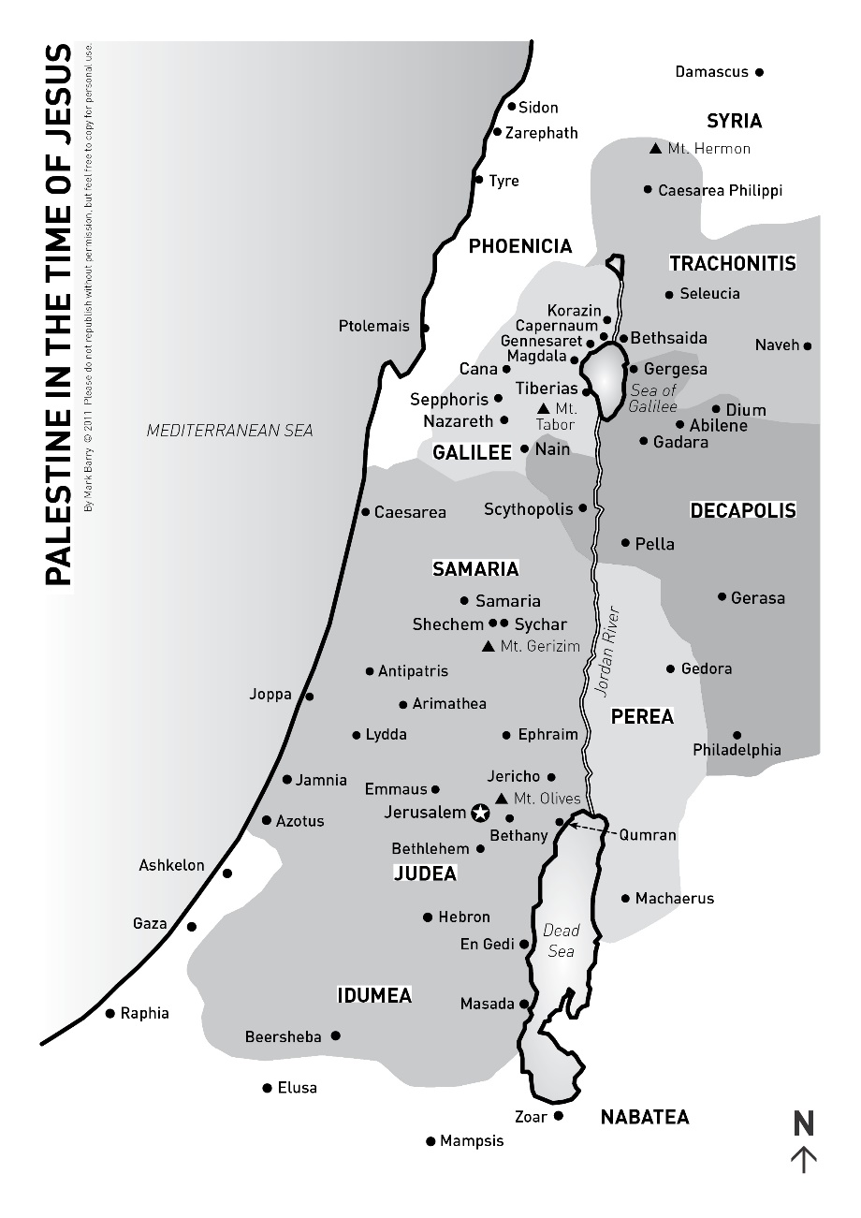
Launch of the Great Commission
The persecution in Jerusalem Acts 8:1 was a huge catalyst for the launch of the Great Commission and the expansion of the church beyond Jerusalem
  Acts 8:5-8 - ⁵ Philip went down to the city^{[a]} of Samaria and proclaimed to them the Christ. ⁶ And the crowds with one accord paid attention to what was being said by Philip, when they heard him and saw the signs that he did.⁷ For unclean spirits, crying out with a loud voice, came out of many who had them, and many who were paralyzed or lame were healed. ⁸ So there was much joy in that city.
  Samaria was populated by “half-breeds” in a Jews mind. These people we descendants of Jews who had intermarried with people from other cultures after the Babylonian conquest. Jews generally avoided Samaria!
  Acts 8:14-17 - Peter & John visit Samaria to witness the Samaritans faith for themselves
  Acts 8:25 - Peter & John return to Jerusalem “preaching the gospel in many villages of the Samaritans.”
Notes:
Caesarea Philippi – city on the eastern side of the Sea of Galilee filled with temples to pagan gods

Slide 23
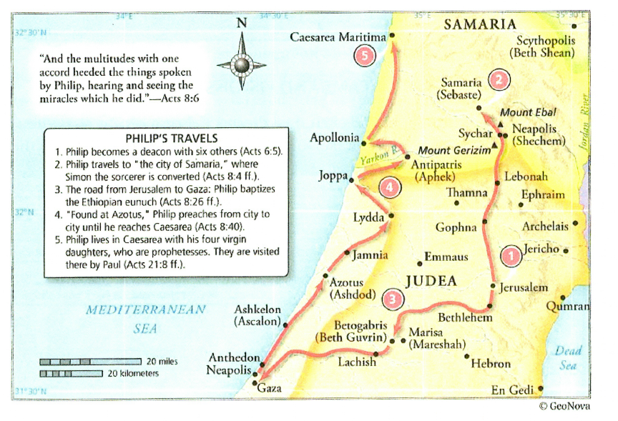
Philip’s Travels
Notes:
Ethiopian eunuch appears to have been a Jew on a pilgrimage to worship in Jerusalem. Upon his conversion he would have taken the Gospel back to Ethiopia, a country that resided between Egypt and the Red Sea south of the Mediterranean as best I can tell.

Slide 24
Launch of the Great Commission
The persecution in Jerusalem Acts 8:1 was a huge catalyst for the launch of the Great Commission and the expansion of the church beyond Jerusalem
  Acts 9 - Saul is heading to the synagogue in Damascus to persecute any Jewish Christians he finds there
  Acts 9:4-5 - Jesus appears to Saul and asks him why he is persecuting him
  Acts 9:15 - The Lord reveals to Ananias, his chosen instrument to deliver the Holy Spirit to Saul and baptize him, his plans for Saul and his ministry which includes both Jews and Gentiles.
    ¹⁵ But the Lord said to him, “Go, for he is a chosen instrument of mine to carry my name before the Gentiles and kings and the children of Israel.
Notes:
Caesarea Philippi – city on the eastern side of the Sea of Galilee filled with temples to pagan gods

Slide 25
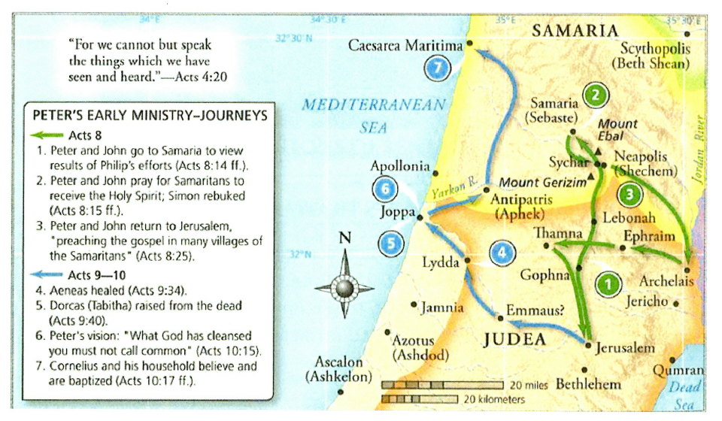
Peter’s Travels

Slide 26
Launch of the Great Commission
Peter takes the Gospel to the Gentiles
  Acts 9:32-43 - Peter ministers throughout Judea and stops in the city of Joppa
  Acts 10:1-8 - Introduction to Cornelius, a Roman Centurion and a Gentile who “feared God with all his household, who gave generously to the people and prayed to God always” (vs. 2) An angel appears to Cornelius and instructs him to send for Peter and where to find him.
  Acts 10:10-16 - Peter’s vision of animals considered ceremonially unclean to eat per Jewish Law which God commands him to kill and eat. When Peter questions the command he is told “What God has cleansed you must not call common.” (vs. 15)
  Acts 10:17-22 - The men Cornelius sent arrive and ask for Peter as the angel instructed. “¹⁹ And while Peter was pondering the vision, the Spirit said to him, “Behold, three men are looking for you. ²⁰ Rise and go down and accompany them without hesitation,^{[a]} for I have sent them.”” (vs 19-20)
  Acts 10:23-33 - Peter travels to Caesarea and meets Cornelius even though it was unlawful. ²⁸ And he said to them, “You yourselves know how unlawful it is for a Jew to associate with or to visit anyone of another nation, but God has shown me that I should not call any person common or unclean. ²⁹ So when I was sent for, I came without objection. I ask then why you sent for me.”³⁰ And Cornelius said, “Four days ago, about this hour, I was praying in my house at the ninth hour,^{[a]} and behold, a man stood before me in bright clothing ³¹ and said, ‘Cornelius, your prayer has been heard and your alms have been remembered before God. ³² Send therefore to Joppa and ask for Simon who is called Peter. He is lodging in the house of Simon, a tanner, by the sea.’ ³³ So I sent for you at once, and you have been kind enough to come. Now therefore we are all here in the presence of God to hear all that you have been commanded by the Lord.”
Notes:
Caesarea Philippi – city on the eastern side of the Sea of Galilee filled with temples to pagan gods

Slide 27
Launch of the Great Commission
Peter takes the Gospel to the Gentiles cont…
  Acts 10:34-35 - ³⁴ So Peter opened his mouth and said: “Truly I understand that God shows no partiality, ³⁵ but in every nation anyone who fears him and does what is right is acceptable to him.
  Acts 10:36-43 - Peter presents the Gospel to Cornelius and the Gentiles gathered with him
  Acts 10:44-48 - ⁴⁴ While Peter was still saying these things, the Holy Spirit fell on all who heard the word. ⁴⁵ And the believers from among the circumcised who had come with Peter were amazed, because the gift of the Holy Spirit was poured out even on the Gentiles. ⁴⁶ For they were hearing them speaking in tongues and extolling God. Then Peter declared, ⁴⁷ “Can anyone withhold water for baptizing these people, who have received the Holy Spirit just as we have?” ⁴⁸ And he commanded them to be baptized in the name of Jesus Christ.
  The cycle was now complete! Jews -> Samaritans (ie half-breeds) -> Gentiles
    Peter, the foundation upon which the Lord built His Church, was witness to them all
  Acts 11:1-18 - Peter explains his actions and God’s work amongst the Gentiles to upset Jewish Christians
  Acts 11:17-18 - ¹⁷ If then God gave the same gift to them as he gave to us when we believed in the Lord Jesus Christ, who was I that I could stand in God's way?” ¹⁸ When they heard these things they fell silent. And they glorified God, saying, “Then to the Gentiles also God has granted repentance that leads to life.”
Notes:
Caesarea Philippi – city on the eastern side of the Sea of Galilee filled with temples to pagan gods

Slide 28
Launch of the Great Commission
A Turning Point in Acts:
  Acts 11:19-21 - ¹⁹ Now those who were scattered because of the persecution that arose over Stephen traveled as far as Phoenicia and Cyprus and Antioch, speaking the word to no one except Jews. ²⁰ But there were some of them, men of Cyprus and Cyrene, who on coming to Antioch spoke to the Hellenists^{[a]} also, preaching the Lord Jesus. ²¹ And the hand of the Lord was with them, and a great number who believed turned to the Lord.
    Another account of the persecution in Jerusalem spreading the Gospel, but it was only being taught to Jews…
    “Hellenists” in vs 20 are another name for Greeks. The Jewish Christians from Cyprus and Cyrene began witnessing to Gentiles in Antioch, of which “a great number turned to the Lord”!
  Acts 11:22-26 - ²² The report of this came to the ears of the church in Jerusalem, and they sent Barnabas to Antioch. ²³ When he came and saw the grace of God, he was glad, and he exhorted them all to remain faithful to the Lord with steadfast purpose, ²⁴ for he was a good man, full of the Holy Spirit and of faith. And a great many people were added to the Lord.²⁵ So Barnabas went to Tarsus to look for Saul, ²⁶ and when he had found him, he brought him to Antioch. For a whole year they met with the church and taught a great many people. And in Antioch the disciples were first called Christians.
    The focus of the book of Acts, the continued spread of the Church, and the continued implementation of the Great Commission is moving from Peter to Paul (aka Saul), and to a lesser extent from the Jews to the Gentiles
Notes:
Caesarea Philippi – city on the eastern side of the Sea of Galilee filled with temples to pagan gods

Slide 29
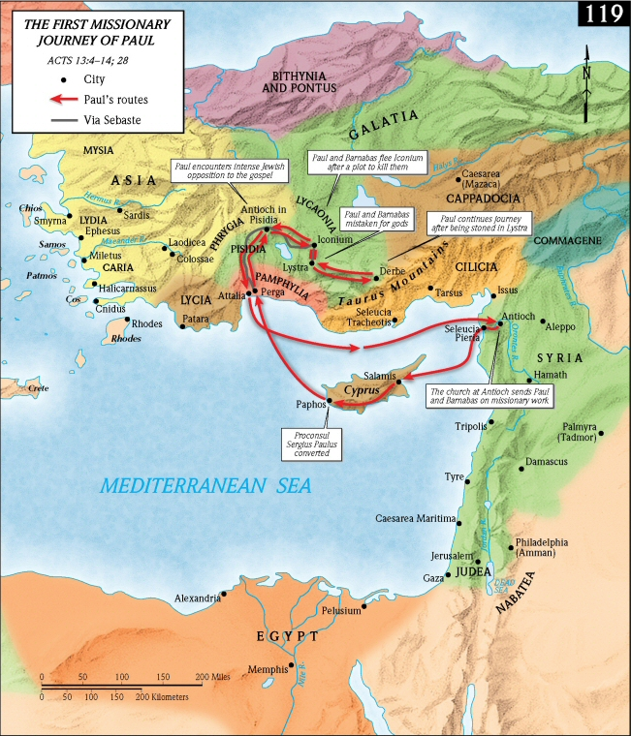

Slide 30
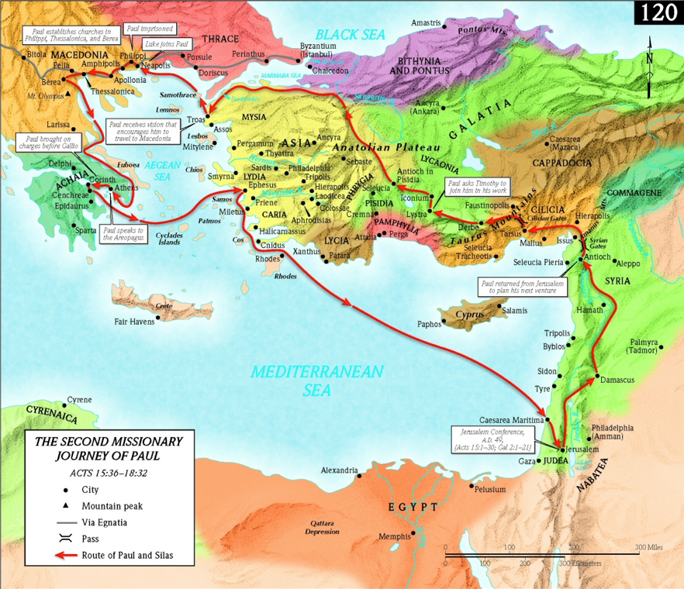

Slide 31
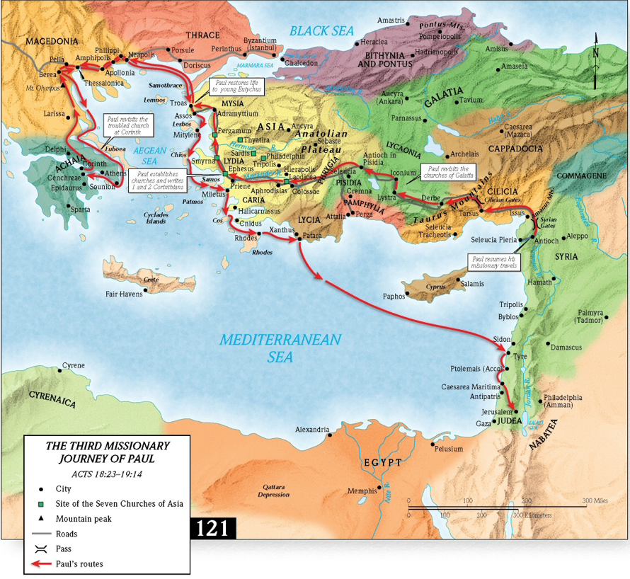

Slide 32
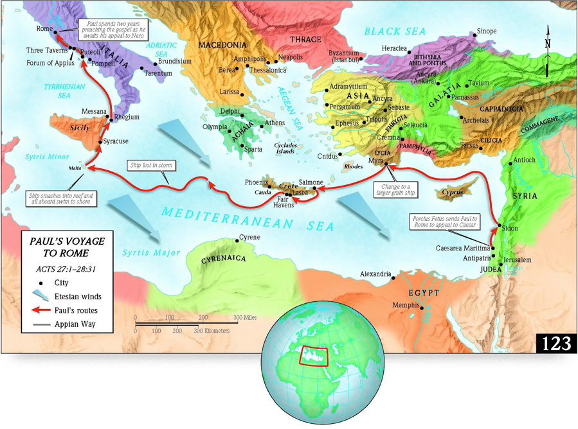

Slide 33
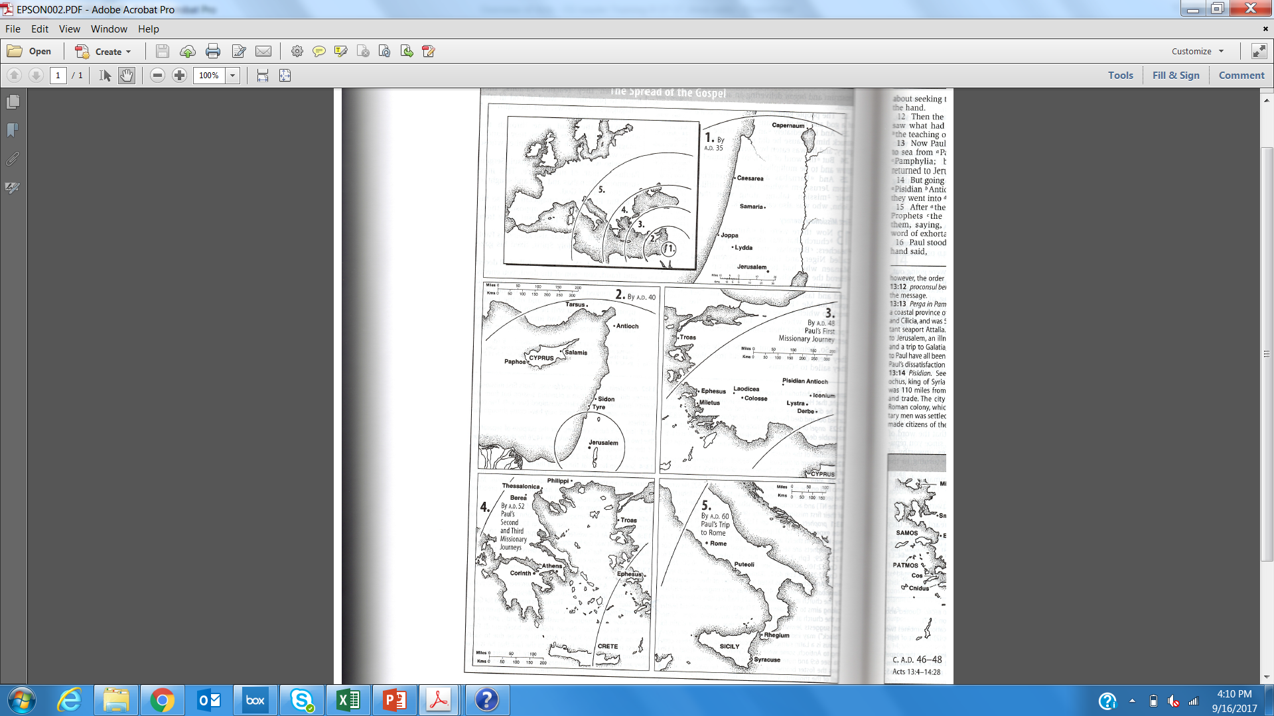
The Spread of the Gospel in Acts
A.D. 60
A.D. 52
A.D. 48
A.D. 40
A.D. 35
Zondervan NASB Study Bible

Slide 34
Application
Be intentional about guiding your group to looking for the work of the Holy Spirit throughout the book of Acts. I have just scratched the surface with what we have discussed!
Encourage your group to reflect on the implications of the Holy Spirit in their lives. The same Holy Spirit that indwelt the early church and accomplished the work recorded in Acts indwells us today!
Lead your group in being more aware of the Holy Spirit’s work in your day to day lives. Also lead in regularly praying for the Holy Spirit to be active in your lives, in your time in prayer, time in the Word, relationships, etc. Also pray for sensitivity to the Holy Spirit’s leading.
Take time to reflect on the implications of the Great Commission in your life, and lead your group to do the same. There are many excellent examples to reflect on and follow in the book of Acts!
Reflect on discipleship as portrayed in the book of Acts and lead your group to do the same. Jesus certainly did turn the disciples into “fishers of men” as he promised as evidenced by the book of Acts!

Slide 35
Appendix

Slide 36
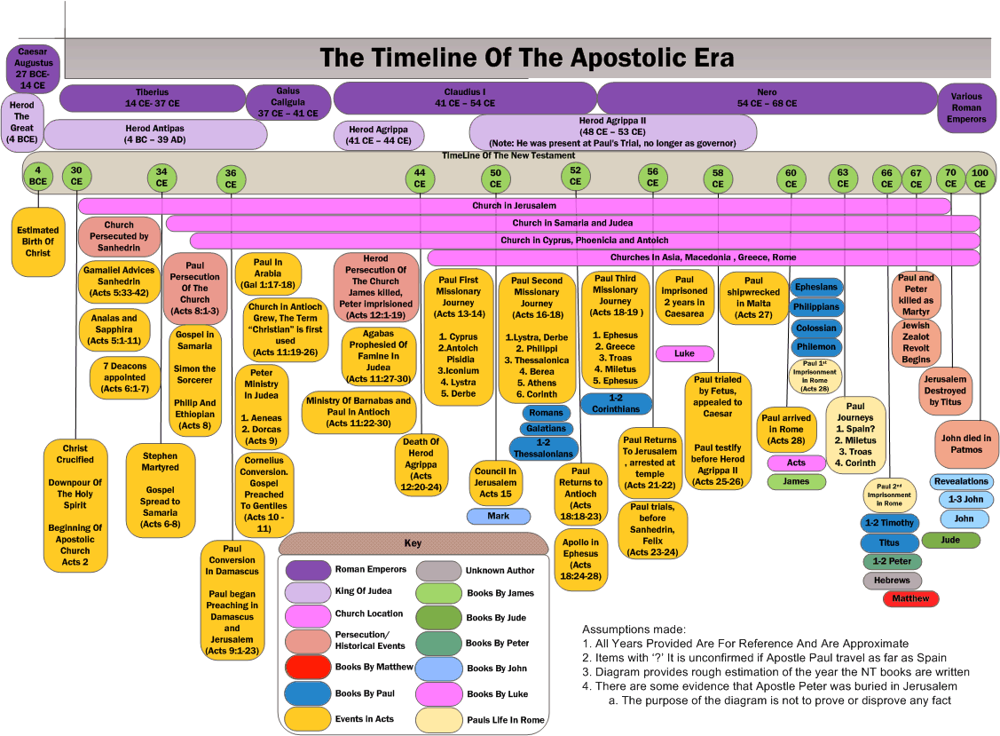

Slide 38
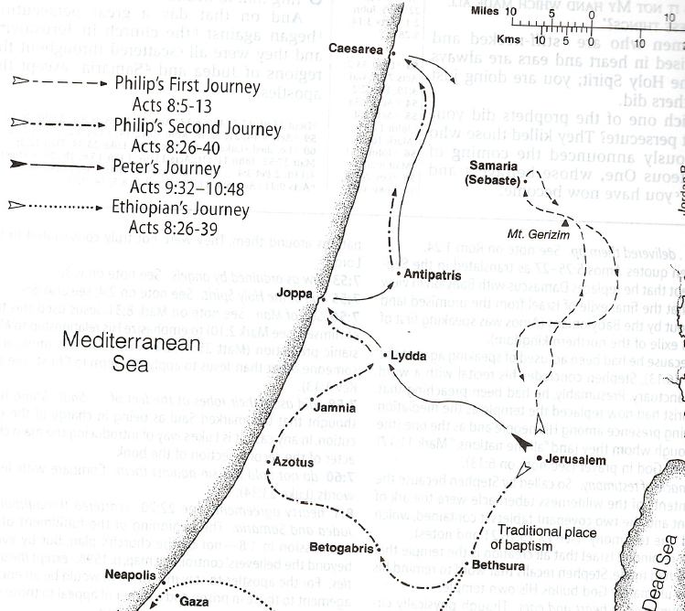
Philip’s and Peter’s Missionary Journeys
Zondervan NASB Study Bible

Slide 39
1. The Spread of the Gospel by A.D. 35
Zondervan NASB Study Bible

Slide 40
2. The Spread of the Gospel by A.D. 40
Zondervan NASB Study Bible

Slide 41
3. The Spread of the Gospel by A.D. 48
Zondervan NASB Study Bible

Slide 42
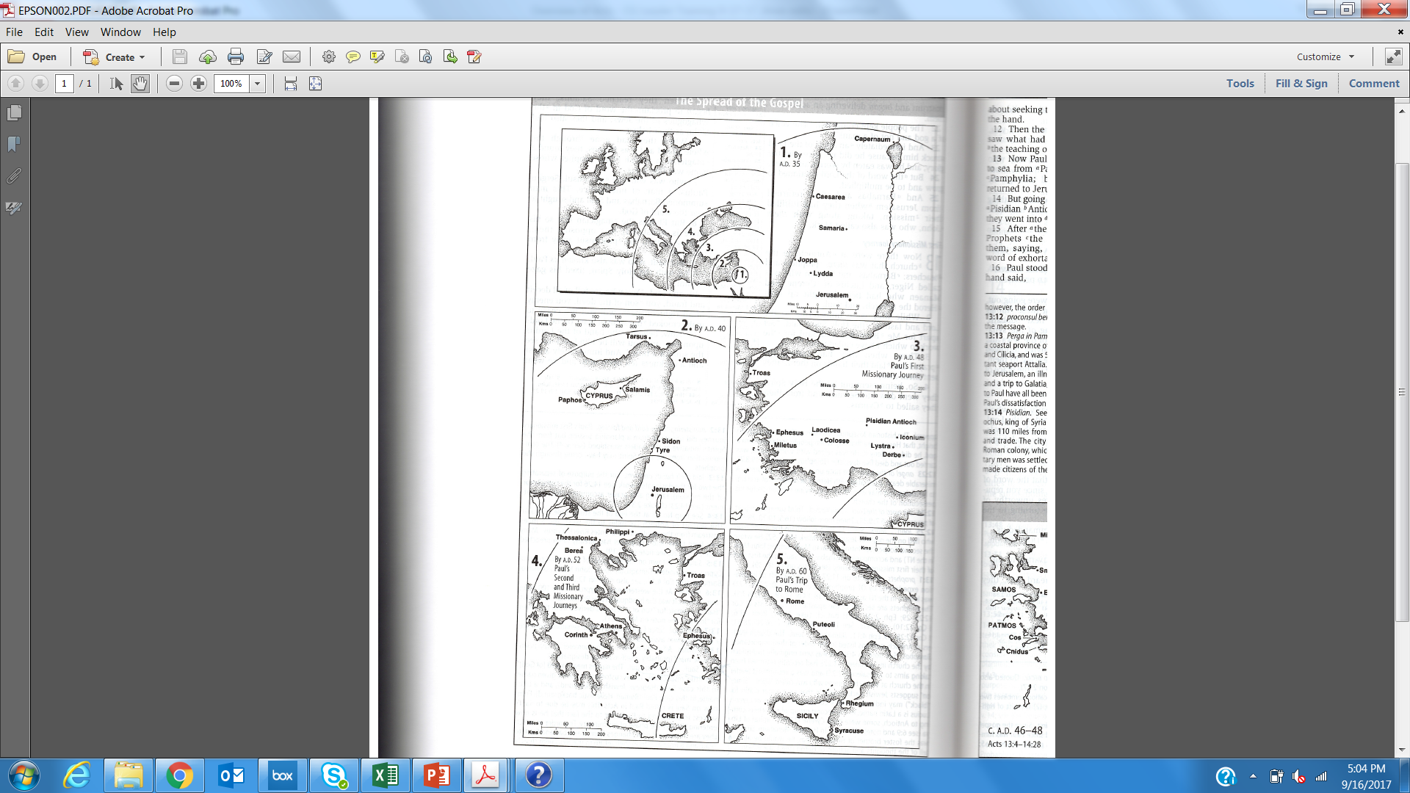
4. The Spread of the Gospel by A.D. 52
Zondervan NASB Study Bible

Slide 43
5. The Spread of the Gospel by A.D. 60
Zondervan NASB Study Bible

